Slide 1
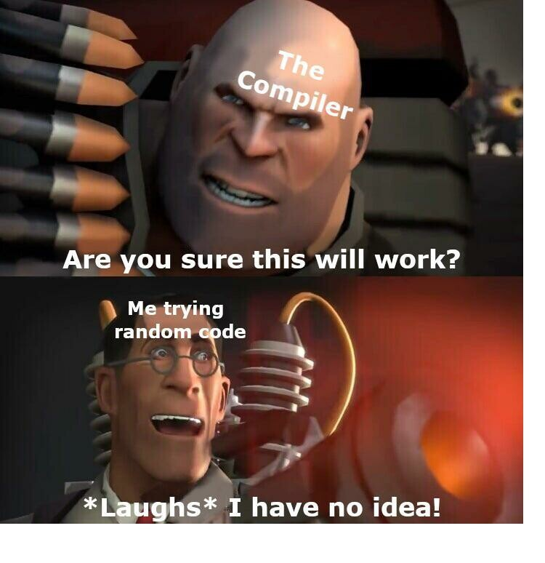

Slide 2
CS2308
Gentry Atkinson
Lecture 2.1
Algorithmic Analysis

Slide 3
What is an Algorithm
Step-by-step instructions that tell a computing agent how to solve some problem using resources.
Resources:
  Memory
  Time (measured as CPU cycles)
Type of Instructions:
  Sequential (1 action)
  Conditional (0 or 1 action)
  Loops (0 or more actions)

Slide 4
Psuedo-Code
a human-language description of the sequential, conditional, and iterative operations of an algorithm.
No rigid syntax.
Clarity, organization, and completeness are important.
Can be implemented in any computer language.

Slide 5
Example: Find the Largest Number
Given a list L of integers of size n.
Set Largest to the first value in L, L0.
For all remaining elements in L:
  If Li is larger than largest:
    Set Largest to Li
Output Largest

Slide 6
Measuring Time Efficiency
For this list : {2, 6, 3, 4, 8}
  Step 1 happens 0 times.
  Step 2 happens 1 time.
  Step 3a makes 4 comparisons.
  Step 3ai does 2 assignments.
  Step 4 happens 0 times.
For a list with length n=5, our algorithm performs 7 actions.
Given a list L of integers of size n.
Set Largest to the first value in L, L0.
For all remaining elements in L:
  If Li is larger than largest:
    Set Largest to Li
Output Largest

Slide 7
Generalizing This Measure
For a list with length n:
  Step 0 always happens 0 times.
  Step 1 always happens 1 time.
  Step 3a always does n-1 comparisons.
  Step 3ai will happen at most n-1 times or as little as 0 times.
Our algorithm will perform at least n actions and at most 2n-1 actions.

Slide 8
Big O notation
It would be cumbersome to tell a colleague that our algorithm uses “n to 2n-1” steps.
Big O is a simplified notation:
  Drop all constants
  Keep only the highest order operation
Examples:
  2n-1 is O(n)
  n² + 5n is O(n²)
  1000000 is O(1) or O(c)

Slide 9
Orders of Big O
O(1) constant time
O(log(n)) log time
O(n) linear time
O(nlog(n)) log linear time
O(n²) polynomial time
O(2^{n}) exponential time
O(n!) factorial time
Fastest
Slowest

Slide 10
Comparison of Orders
Let’s assume that one operation takes one second.
 | 2 step | 8 step | 32 step | 128 step | 512 step | 2048 step | 8192 step
constant | 1 sec. | 1 sec. | 1 sec. | 1 sec. | 1 sec. | 1 sec. | 1 sec.
log(n) | 1 sec. | 3 sec. | 5 sec. | 7 sec. | 9 sec. | 11 sec. | 13 sec.
n | 2 sec. | 8 sec. | 32 sec. | 2 min. | 8 min. | 34 min. | 2 hours
nlog(n) | 2 sec. | 24 sec. | 2 min. | 14 min. | 1 hour | 6 hours | 1 day
n² | 4 sec. | 1 min. | 17 min. | 4 hours | 3 days | 48 days | 2 years
2^{n} | 4 sec. | 1 min. | 136 years | 1e31 years | ... | ... | ...
n! | 2 sec. | 11 min. | 8e27 years | 1e208 year | ... | ... | ...

Slide 11
2nd Example: Find the most frequent number
Given a list of integers L of length n
Create lists V and C of length n
For every value in L:
  Try to find Li in V
    If Li is stored at Vj, increment Cj
    Otherwise set Vm to Li and set Cm to 1 where m is the next empty position in the two lists.
Find the index k of the maximum value in C
Output Vk

Slide 12
Space Complexity
We are given the list L, it doesn’t count against the space complexity.
We create 2 lists V and C which both have size n.
To process n values, we need to store 2n values in memory.
Out algorithm is O(n) space complexity.
Given a list of integers L of length n
Create lists V and C of length n
For every value in L:
  Try to find Li in V
    If Li is stored at Vj, increment Cj
    Otherwise set Vm to Li and set Cm to 1 where m is the next empty position in the two lists.
Find the index k of the maximum value in C
Output Vk

Slide 13
Big O Considerations
Not meaningful for small values of n. The Big O measurement only needs to be true after some threshold.
We have assumed so far that our computer only has one processor.
Big O is an upper bound so a linear time algorithm is also in the set of polynomial time algorithms.

Slide 14
Questions or Comments?

